Slide 1
Ksc6103 data STRUCTURE & algorithm analysis
Recursion

Slide 2



LEARNING OUTCOMES
 | Understand the concept of Recursion.
 | Identify the examples of algorithm that apply the use of recursion
 | Explain and evaluate the recursive algorithm and recursive trace.

Slide 3
Overview
Introduction
Recursion Example
Analyzing the time-complexity of recursions
Types of Recursion
Designing Recursive Algorithm
Tower of Hanoi Problem
Summary

Slide 4
INTRODUCTION

Slide 5

Introduction
Two ways to define repetition:
Using loops: for-loop, while-loop etc.
Using recursion
Recursion: It is a technique by which a function makes one or more calls to itself during execution, or by which a data structure relies upon smaller instances of the very same type of structure in its presentation.
Few real examples of recursion in nature:
Fractal patters
Russian Matryoshka Dolls

Slide 6
RECURSION EXAMPLE

Slide 7
Illustrative Example of recursion
Factorial function
Fibonacci
English Ruler
Binary Search (Explain in Topic Search)
File System

Slide 8



The Factorial Function
Definition:
Example:
Recursive Definition:
A recursive definition contains one non-recursive base case and one or more recursive cases.

Slide 9
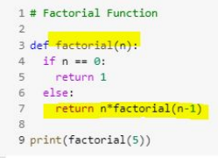
The Factorial Function
The number of ways in which n distinct items can be arranged into a sequence = n!. In other words, permutation of n items = n!.
For example, the characters a, b and c can be arranged in 3! = 3.2.1 = 6 ways: abc, acb, bac, bca, cab and cba.

Slide 10
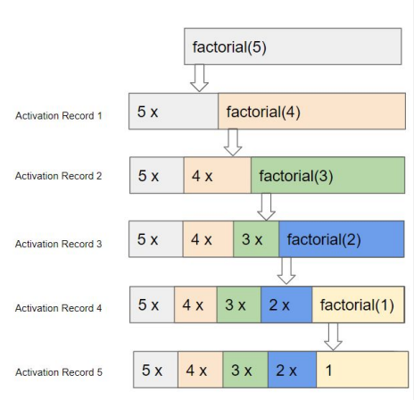
The Factorial Function
Each time a function is called, a structure known as an activation record or frame is created to store information about the progress of that invocation of the function.
Activation record includes a namespace for storing the function call parameters and local variables and information about which command in the body of the function is currently executing.
When the execution of a function leads to a nested function call, the execution of the former function call is suspended and its activation record stores the place in the source code at which the flow of control should continue upon return of the nested call.
There is a different activation record for each active call.

Slide 11
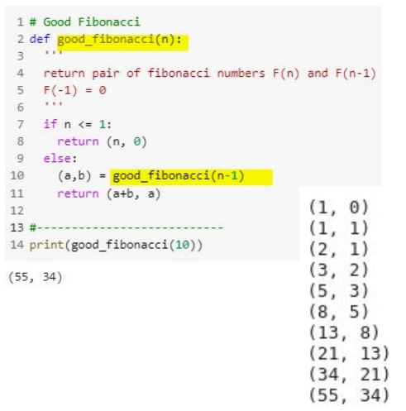
Fibonacci
We modify the requirement by making it return two consecutive numbers instead of one.
Each call leads to only one recursive call with problem size reducing by 1 at each call.
So for n elements, n recursive calls are made.
So the time-complexity of good_fibonacci(n) is O(n).

Slide 12
APPLICATION

Slide 13
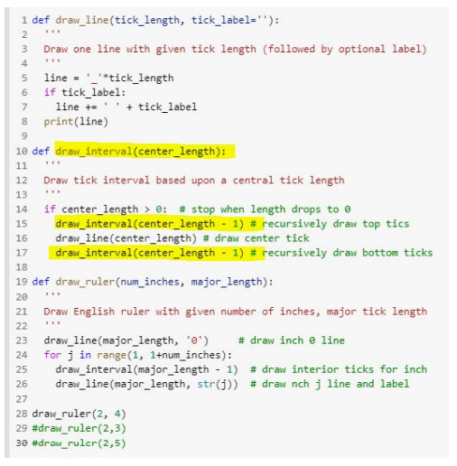
Drawing an English Ruler

Slide 14
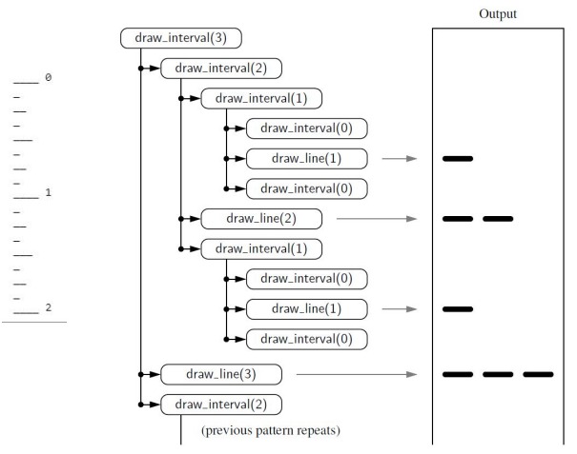
Drawing an English Ruler

Slide 15
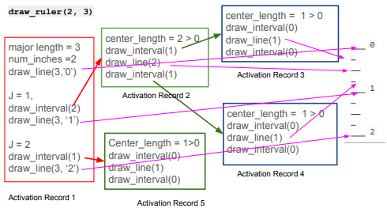
Drawing an English Ruler

Slide 16
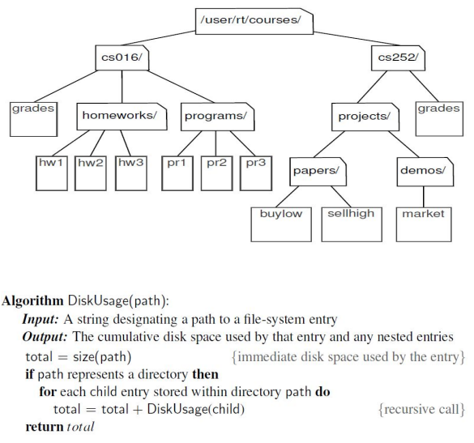
File System
In modern operating system, the file-system directories (or folders) are defined in a recursive way.
Many OS functions such as copying or deleting implement recursive algorithms.
Example: cumulative disk usage for all files and directories within a particular directory.

Slide 17
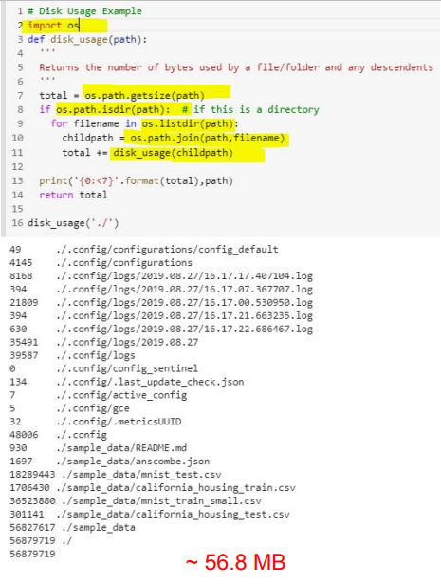
File System
Following functions from Python’s os module will be used:
os.path.getsize(path):
Return the immediate disk usage (measured in bytes) for the file or directory that is identified by the string path
os.path.isdir(path):
Return True if entry designated by string path is a directory; False otherwise
os.listdir(path):
Return a list of strings that are the names of all entries within a directory designated by string path
os.path.join(path, filename):
Compose the path string and filename string using an appropriate operating system separator between the two (‘/’ in Linux)

Slide 18
Analyzing the time-complexity of recursions

Slide 19
Analyzing Recursive Algorithm
Computing Factorials
Each individual activation of factorial() executes a constant number of operations.
To compute factorial(n), there are n+1 activations.
The main function that calls the factorial() function has its own activation record.
Time complexity ~ O(n)

Slide 20
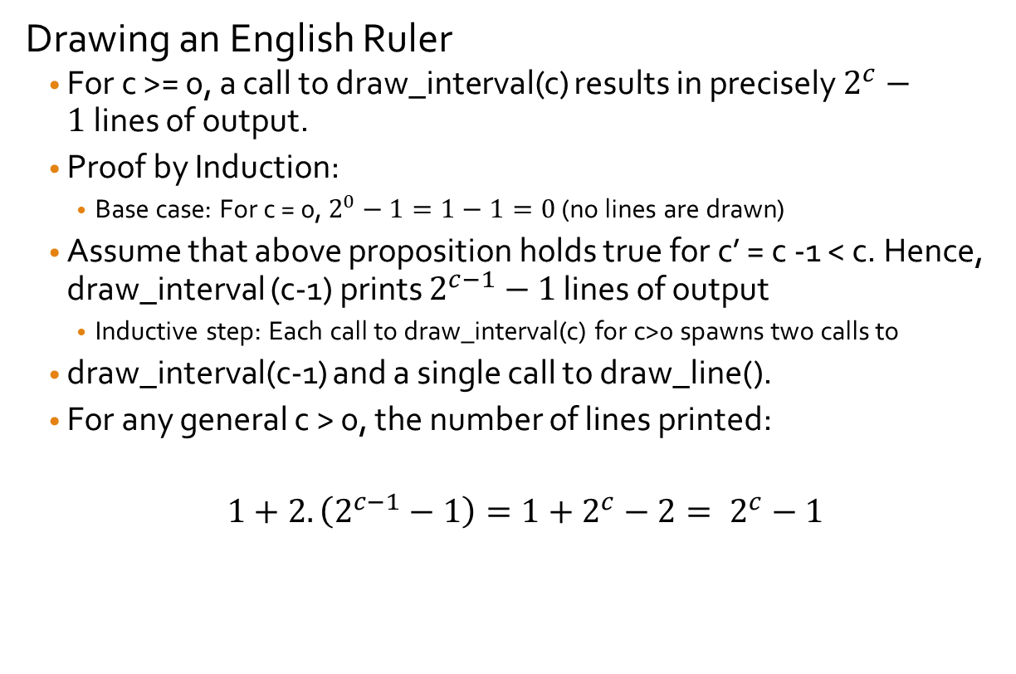
Analyzing the English Ruler Example
Drawing an English Ruler
For c >= 0, a call to draw_interval(c) results in precisely $2^{c}−1$lines of output.
Proof by Induction:
Base case: For c = 0, $2^{0}−1=1−1=0$ (no lines are drawn)
Assume that above proposition holds true for c’ = c -1 < c. Hence, draw_interval (c-1) prints $2^{c−1}−1$ lines of output
Inductive step: Each call to draw_interval(c) for c>0 spawns two calls to
draw_interval(c-1) and a single call to draw_line().
For any general c > 0, the number of lines printed:
$1+2.\left(2^{c−1}−1\right)=1+2^{c}−2= 2^{c}−1$

Slide 21
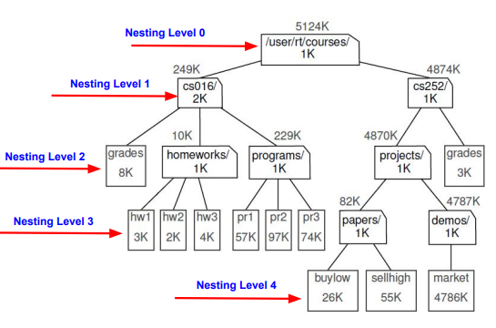
Analyzing Disk space usage algorithm
Total number of file-system entries in a given part of the file system is n (n = 19, in this case).
It can be proved by induction that there is exactly one recursive invocation of disk_usage() upon each entry at the nesting level k.
In the worst case, it has running time of order
A tighter bound O(n) will be where n is the total number of entries in the file-system.
Amortization: We can sometimes get a tighter bound on a series of operations by considering the cumulative effect, rather than assuming that each achieves a worst case.

Slide 22
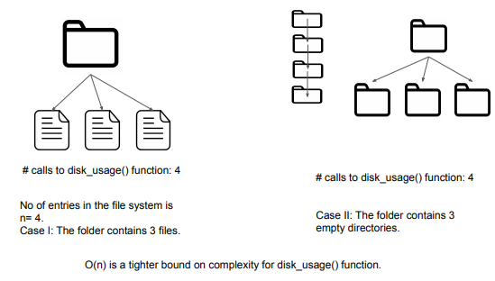
Analyzing Disk space usage algorithm

Slide 23
TYPES OF RECURSION

Slide 24
Further Example of Recursion
Linear Recursion - one recursive call starts at most one other.
Binary recursion - one recursive call may start two others.
Multiple recursion - one recursive call may start three or more others.

Slide 25
Linear Recursion
Linear Recursion - one recursive call starts at most one other.
Examples:
➔ Factorial
➔ Good_fibonacci
➔ Binary search
Linear recursion terminology reflects the structure of the recursion trace, not the asymptotic analysis of the running time.

Slide 26
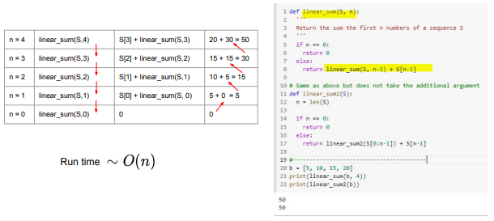
Summing the elements of a sequence

Slide 27
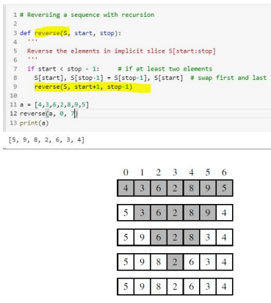

Reversing a Sequence with Recursion
The code is guaranteed to terminate after a total
of recursive calls.
Runtime

Slide 28
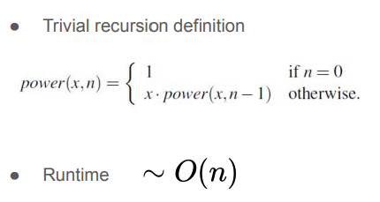
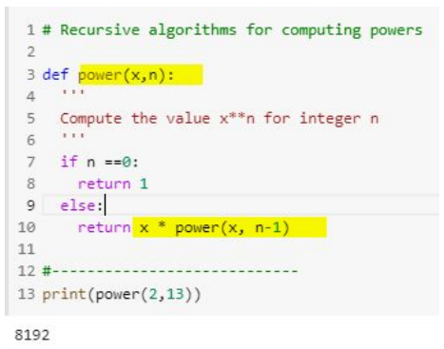
Recursive algorithms for computing Powers

Slide 29
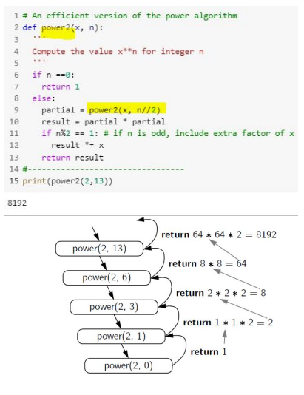
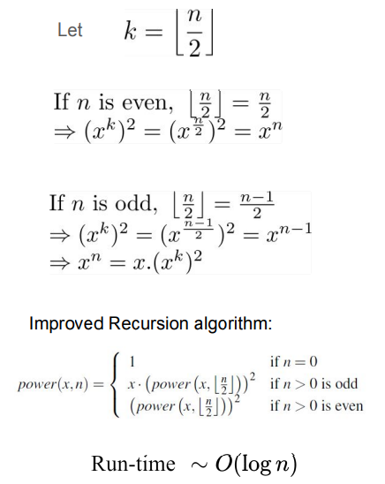
Recursive algorithms for computing Powers

Slide 30
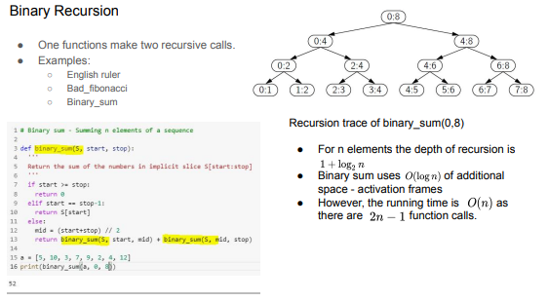
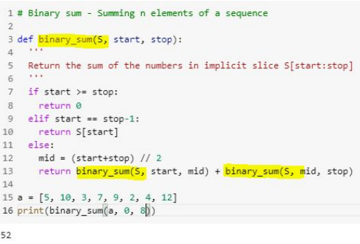
Binary Recursion

Slide 31
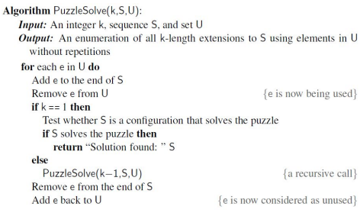
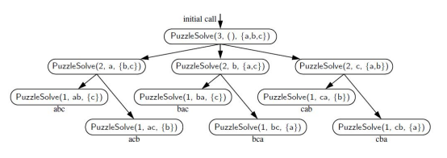
Multiple Recursion
Multiple recursion is a process in which a function may take more than two recursive calls.
Examples:
Disk space usage of a file system.
Solving combinatorial puzzles.

Slide 32
Advantages and Disadvantages of Recursion
Advantages of Recursion
provides a succinct way of achieve repetition by avoiding nested loops.
Makes the code readable and efficient.
The usefulness of recursion comes at a modest cost.
Python interpreter must maintain activation records that keep track of the state of each nested call.
Such calls should be avoided where memory is at a premium.
Some forms of recursion can be eliminated without any use of auxiliary memory. e.g - tail recursions.

Slide 33
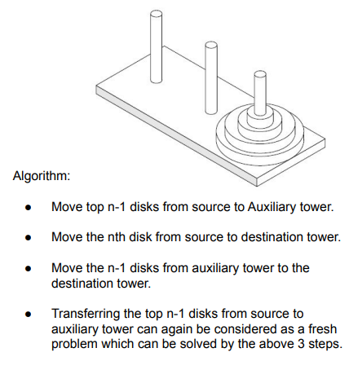
Tower of Hanoi
It consists of 3 rods or pegs or towers a number of disks of different sizes which can slide onto any rod.
The puzzle starts with the disks on one rod in ascending order of its size, smallest at the top, thus making a conical tower shape.
The objective is to move the entire stack to another rod, satisfying the following rules:
Only one disk may be moved at a time.
Each move consists of taking the uppermost disk in one rod and sliding onto another rod that may or may not have disks in them.
No disk may be placed on the top of a smaller disk.

Slide 34
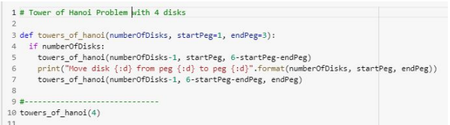
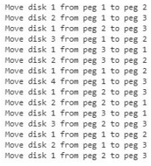
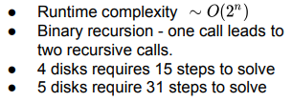
Tower of Hanoi

Slide 35
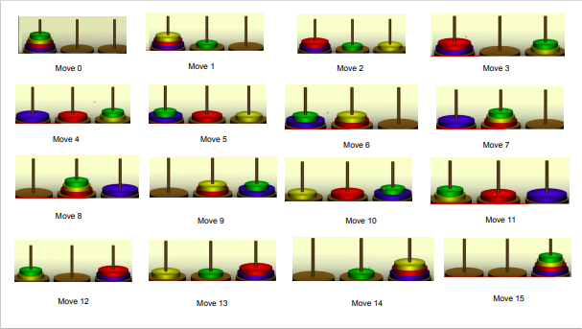
Tower of Hanoi

Slide 36
Summary
We cover the following topics in this lecture:
What is recursion and why is it needed?
Some examples of recursive algorithm
Analyzing their runtime complexity & memory complexity
Different types run time analysis of recursion
Downside of recursion

